Slide 1
Celebrity detection using AWS Rekognition
By Benjamin sklar June 2017 Cloud 230B

Slide 2
Overview

Slide 3
architecture
Rekognition face-collection: stores face meta-data (so full image analysis is not needed to compare faces in collection)
S3 bucket for image file storage
DynamoDB tables:
CelebrityImageFiles: filename, image type, height&width, source, imageid from indexFaces call
CelebrityFaces: face data including source file, face meta-data
CelebrityFaceMatches: many-many face pairs with Similarity value
Lambda functions
trigCelebrityImageFiles: on insert into CelebrityImageFaces, calls indexFaces, and places data in CelebrityFaces
trigCelebrityFaces: on insert into CelebrityFaces, calls searchFaces, and places data in CelebrityFaceMatches
Supporting functionality: IAM roles, Cognito for website access

Slide 4
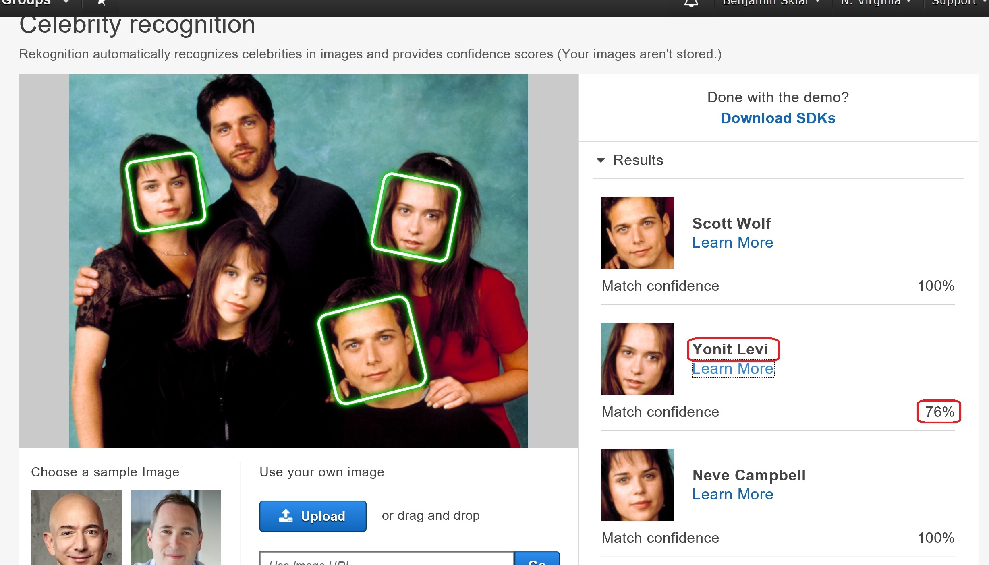
Rekognition Celebrity recogntion
recognizeCelebrities API does facial recognition and compares faces with AWS’s celebrity face-collection (provides Name and imdb.com url)

Slide 5
ToDO
Make use of Rekognition API recognizeCelebrities in lambda function trigCelebrityImageFiles
Write API Gateway & Lambda function to upload new images; Take URL or local file, validate as JPG or PNG image, detect height & width, upload to S3 bucket, and put new entry into CelebrityImageFiles table. (Write webpage to use this)
On website show bounding boxes where appropriate
Update webpages allimages.html and image.html into files.html
Clean and style webpages
Limit IAM roles to least-privilege-needed

Slide 6
Links
Website: http://benjaminsklar-celebrity-images.s3-website-us-east-1.amazonaws.com
Source: https://github.com/brskl/Cloud230B_final
AWS Documentation: https://aws.amazon.com/rekognition/

